Slide 1
Forest Park Southeast, Botanical Heights, Central West End, Medical Campus
Monthly Crime Report: December 2020
Washington University Medical Center

Slide 2
Forest Park Southeast : Summary Notes
25 total crimes in December 2020
-38% change compared to December 2019 (40 total crimes)
2 crime(s) against persons in December 2020
-71% change compared to December 2019 (7 crimes against persons)
327 total crimes in 2020
0% change compared to this time in 2019 (327 total crimes)
47 crime(s) against persons in 2020
0% change compared to this time in 2019 (47 crimes against persons)

Slide 3
Forest Park Southeast : Year to Year Comparison
2019 | 2019 | 2019 | 2019 | 2019 | 2019 | 2019 | 2019 | 2019 | 2019 | 2019 | 2019 | 2019 | 2019
Part 1 Crimes | Jan | Feb | Mar | Apr | May | Jun | Jul | Aug | Sep | Oct | Nov | Dec | Total
Aggravated Assault | 0 | 3 | 1 | 2 | 2 | 4 | 2 | 0 | 2 | 5 | 0 | 5 | 26
Arson | 0 | 0 | 1 | 0 | 0 | 1 | 0 | 0 | 0 | 0 | 0 | 0 | 2
Burgalry | 0 | 0 | 1 | 1 | 0 | 0 | 3 | 1 | 4 | 8 | 3 | 1 | 22
Homicide | 0 | 0 | 0 | 0 | 0 | 0 | 0 | 0 | 1 | 0 | 0 | 0 | 1
Larceny | 7 | 10 | 15 | 12 | 9 | 21 | 17 | 19 | 24 | 35 | 17 | 32 | 218
Motor Vehicle Theft | 3 | 6 | 1 | 2 | 0 | 4 | 6 | 1 | 8 | 3 | 3 | 0 | 37
Rape | 0 | 0 | 0 | 0 | 0 | 0 | 0 | 0 | 0 | 0 | 0 | 0 | 0
Robbery | 1 | 0 | 1 | 1 | 2 | 5 | 2 | 1 | 2 | 3 | 1 | 2 | 21
Total | 11 | 19 | 20 | 18 | 13 | 35 | 30 | 22 | 41 | 54 | 24 | 40 | 327
2020 | 2020 | 2020 | 2020 | 2020 | 2020 | 2020 | 2020 | 2020 | 2020 | 2020 | 2020 | 2020 | 2020
Part 1 Crimes | Jan | Feb | Mar | Apr | May | Jun | Jul | Aug | Sep | Oct | Nov | Dec | Total
Aggravated Assault | 1 | 5 | 4 | 0 | 0 | 6 | 5 | 6 | 1 | 3 | 1 | 0 | 32
Arson | 0 | 0 | 0 | 0 | 0 | 0 | 0 | 0 | 1 | 0 | 0 | 2 | 3
Burgalry | 3 | 1 | 4 | 1 | 0 | 0 | 4 | 3 | 2 | 2 | 0 | 2 | 22
Homicide | 0 | 0 | 0 | 0 | 0 | 0 | 0 | 0 | 0 | 0 | 0 | 0 | 0
Larceny | 25 | 15 | 14 | 10 | 8 | 12 | 6 | 13 | 12 | 40 | 40 | 16 | 211
Motor Vehicle Theft | 2 | 5 | 2 | 3 | 3 | 2 | 5 | 5 | 2 | 7 | 4 | 3 | 43
Rape | 0 | 0 | 0 | 0 | 1 | 0 | 0 | 0 | 0 | 0 | 0 | 0 | 1
Robbery | 1 | 6 | 1 | 0 | 2 | 0 | 0 | 1 | 0 | 2 | 0 | 2 | 15
Total | 32 | 32 | 25 | 14 | 14 | 20 | 20 | 28 | 18 | 54 | 45 | 25 | 327

Slide 4
Forest Park Southeast : Summary Tables
Day of the Week | Number of Crimes
Sun | 4
Mon | 3
Tue | 5
Wed | 1
Thu | 2
Fri | 6
Sat | 4
Total | 25
Part 1 Crimes | Number of Crimes
Arson | 2
Burgalry | 2
Larceny | 16
Motor Vehicle Theft | 3
Robbery | 2
Total | 25
Crimes Against Persons | Number of Crimes
FALSE | 23
TRUE | 2
Total | 25
Time of Day | Number of Crimes
Day | 24
Night | 1
Total | 25

Slide 5
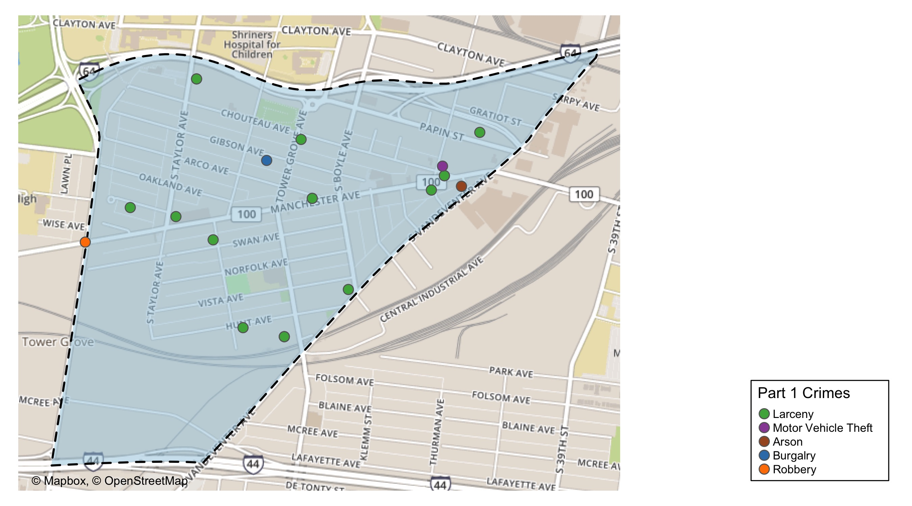
Forest Park Southeast : Total Crime Map

Slide 6
Botanical Heights : Summary Notes
8 total crimes in December 2020
-27% change compared to December 2019 (11 total crimes)
0 crime(s) against persons in December 2020
-100% change compared to December 2019 (2 crimes against persons)
73 total crimes in 2020
-16% change compared to this time in 2019 (87 total crimes)
10 crime(s) against persons in 2020
-38% change compared to this time in 2019 (16 crimes against persons)

Slide 7
Botanical Heights : Year to Year Comparison
2019 | 2019 | 2019 | 2019 | 2019 | 2019 | 2019 | 2019 | 2019 | 2019 | 2019 | 2019 | 2019 | 2019
Part 1 Crimes | Jan | Feb | Mar | Apr | May | Jun | Jul | Aug | Sep | Oct | Nov | Dec | Total
Aggravated Assault | 0 | 0 | 0 | 0 | 4 | 0 | 0 | 1 | 0 | 0 | 2 | 1 | 8
Arson | 0 | 0 | 0 | 0 | 0 | 0 | 0 | 0 | 0 | 0 | 0 | 0 | 0
Burgalry | 2 | 0 | 0 | 2 | 0 | 0 | 1 | 1 | 3 | 0 | 1 | 2 | 12
Homicide | 0 | 0 | 0 | 0 | 0 | 0 | 0 | 0 | 0 | 0 | 0 | 0 | 0
Larceny | 2 | 3 | 6 | 3 | 3 | 3 | 9 | 1 | 5 | 4 | 3 | 5 | 47
Motor Vehicle Theft | 1 | 1 | 3 | 0 | 1 | 1 | 0 | 1 | 0 | 1 | 1 | 2 | 12
Rape | 0 | 0 | 0 | 0 | 0 | 0 | 0 | 0 | 0 | 0 | 0 | 0 | 0
Robbery | 0 | 2 | 0 | 0 | 1 | 1 | 0 | 0 | 0 | 3 | 0 | 1 | 8
Total | 5 | 6 | 9 | 5 | 9 | 5 | 10 | 4 | 8 | 8 | 7 | 11 | 87
2020 | 2020 | 2020 | 2020 | 2020 | 2020 | 2020 | 2020 | 2020 | 2020 | 2020 | 2020 | 2020 | 2020
Part 1 Crimes | Jan | Feb | Mar | Apr | May | Jun | Jul | Aug | Sep | Oct | Nov | Dec | Total
Aggravated Assault | 1 | 0 | 0 | 1 | 0 | 1 | 1 | 2 | 1 | 0 | 1 | 0 | 8
Arson | 0 | 0 | 0 | 0 | 0 | 0 | 0 | 0 | 0 | 0 | 0 | 0 | 0
Burgalry | 1 | 0 | 1 | 0 | 0 | 0 | 2 | 0 | 3 | 2 | 1 | 3 | 13
Homicide | 1 | 0 | 0 | 0 | 0 | 0 | 0 | 0 | 0 | 0 | 0 | 0 | 1
Larceny | 2 | 6 | 2 | 2 | 3 | 1 | 3 | 2 | 6 | 1 | 9 | 4 | 41
Motor Vehicle Theft | 0 | 0 | 0 | 0 | 2 | 1 | 0 | 1 | 1 | 2 | 0 | 1 | 8
Rape | 0 | 0 | 0 | 0 | 0 | 0 | 0 | 0 | 0 | 0 | 0 | 0 | 0
Robbery | 1 | 0 | 1 | 0 | 0 | 0 | 0 | 0 | 0 | 0 | 0 | 0 | 2
Total | 6 | 6 | 4 | 3 | 5 | 3 | 6 | 5 | 11 | 5 | 11 | 8 | 73

Slide 8
Botanical Heights : Summary Tables
Day of the Week | Number of Crimes
Sun | 2
Mon | 2
Tue | 0
Wed | 0
Thu | 1
Fri | 0
Sat | 3
Total | 8
Part 1 Crimes | Number of Crimes
Burgalry | 3
Larceny | 4
Motor Vehicle Theft | 1
Total | 8
Crimes Against Persons | Number of Crimes
FALSE | 8
Total | 8
Time of Day | Number of Crimes
Day | 7
Night | 1
Total | 8

Slide 9
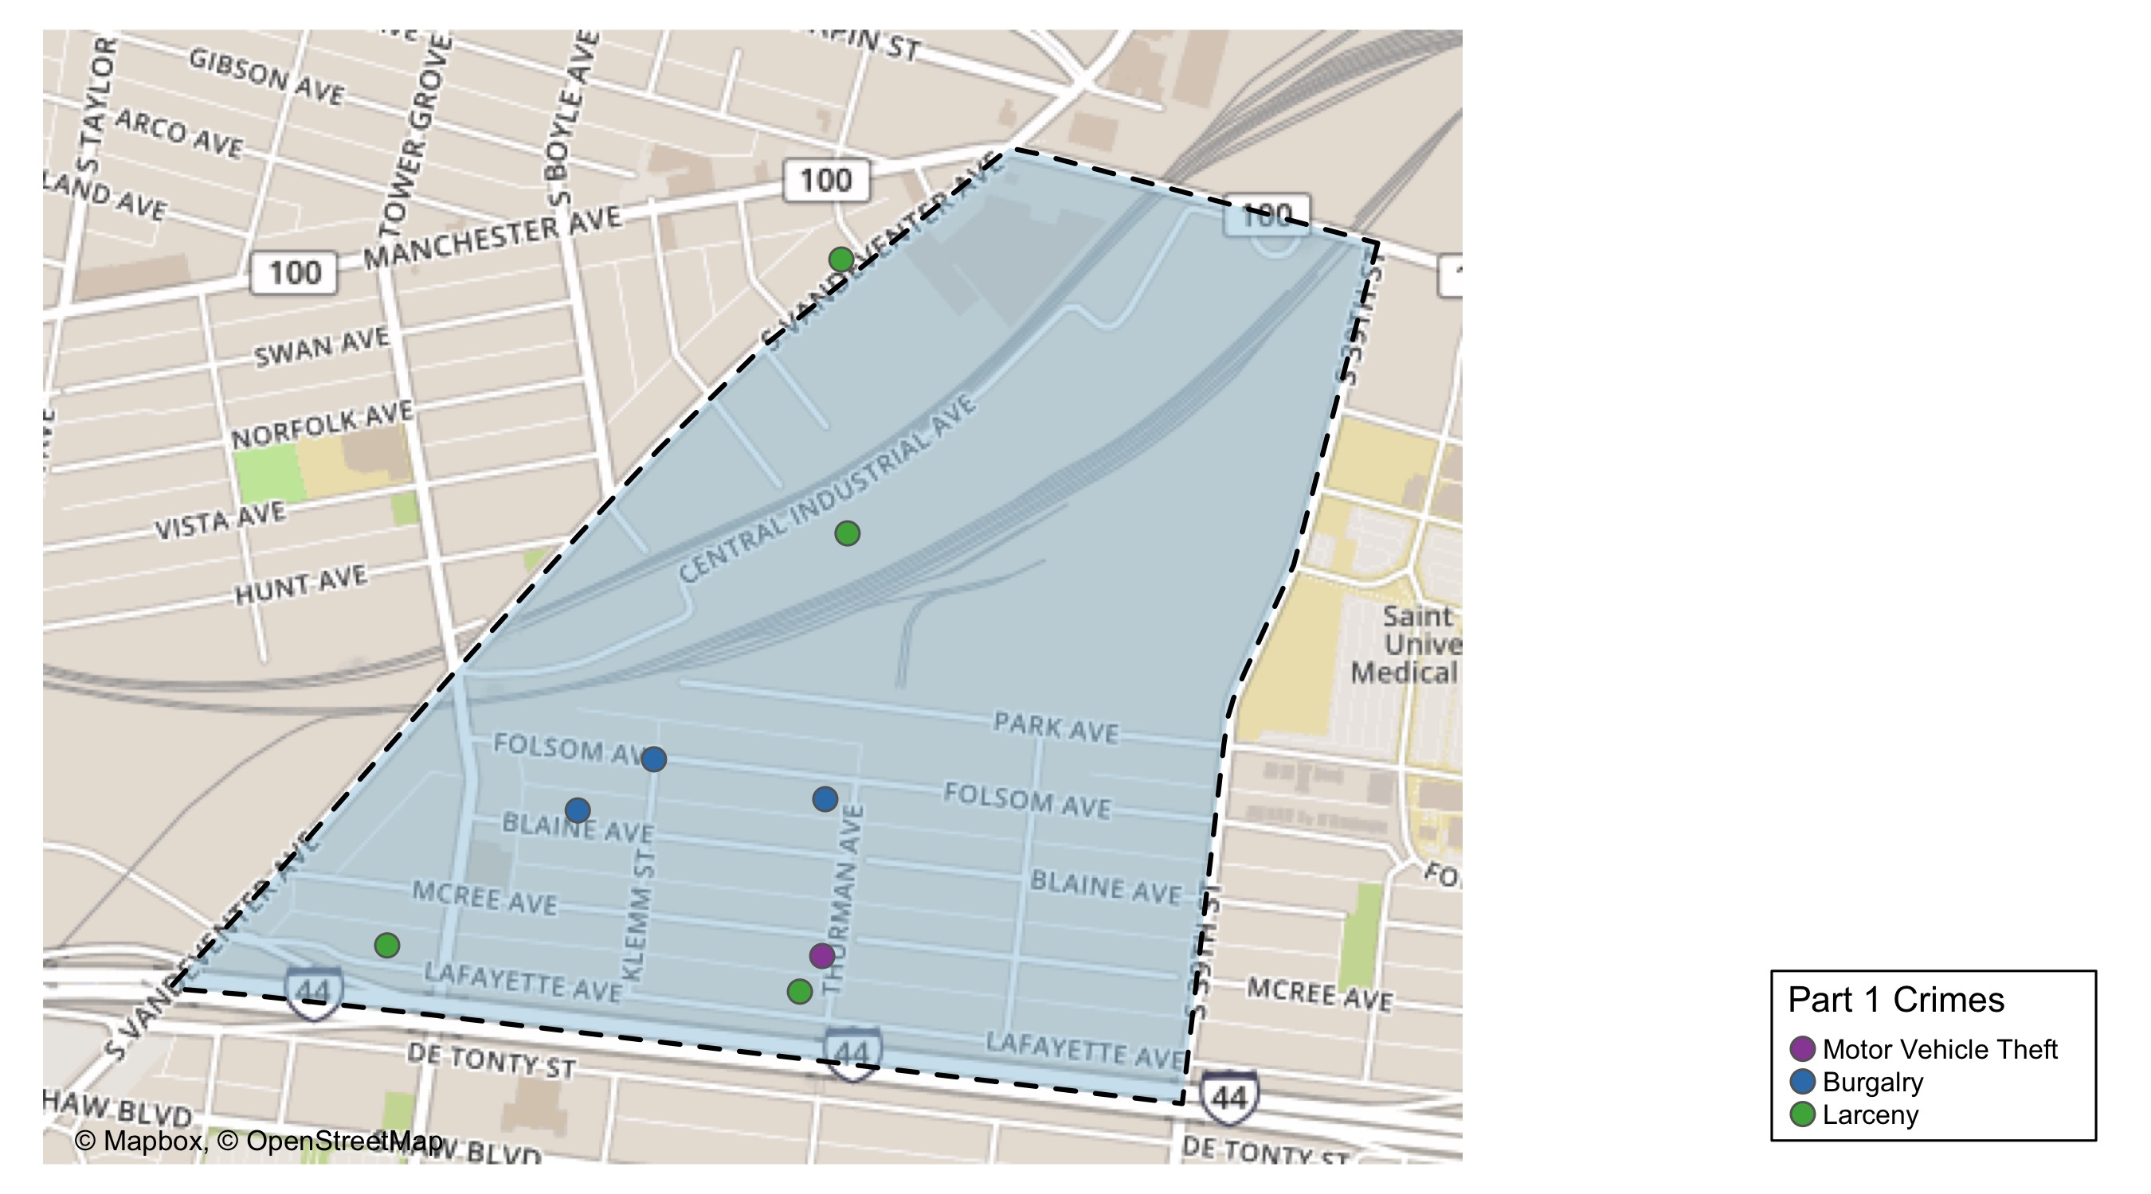
Botanical Heights : Total Crime Map

Slide 10
Central West End : Summary Notes
83 total crimes in December 2020
-17% change compared to December 2019 (100 total crimes)
7 crime(s) against persons in December 2020
-67% change compared to December 2019 (21 crimes against persons)
1186 total crimes in 2020
-2% change compared to this time in 2019 (1208 total crimes)
156 crime(s) against persons in 2020
-2% change compared to this time in 2019 (159 crimes against persons)

Slide 11
Central West End : Year to Year Comparison
2019 | 2019 | 2019 | 2019 | 2019 | 2019 | 2019 | 2019 | 2019 | 2019 | 2019 | 2019 | 2019 | 2019
Part 1 Crimes | Jan | Feb | Mar | Apr | May | Jun | Jul | Aug | Sep | Oct | Nov | Dec | Total
Aggravated Assault | 9 | 4 | 10 | 2 | 8 | 13 | 4 | 11 | 3 | 8 | 4 | 11 | 87
Arson | 0 | 0 | 1 | 0 | 0 | 0 | 0 | 0 | 0 | 0 | 0 | 0 | 1
Burgalry | 3 | 5 | 5 | 9 | 13 | 8 | 13 | 18 | 8 | 8 | 10 | 5 | 105
Homicide | 0 | 0 | 0 | 0 | 0 | 0 | 0 | 0 | 0 | 0 | 0 | 0 | 0
Larceny | 45 | 66 | 65 | 65 | 72 | 56 | 75 | 81 | 63 | 90 | 89 | 65 | 832
Motor Vehicle Theft | 11 | 7 | 3 | 11 | 12 | 9 | 5 | 11 | 9 | 5 | 19 | 9 | 111
Rape | 0 | 0 | 0 | 0 | 0 | 0 | 0 | 0 | 0 | 0 | 0 | 0 | 0
Robbery | 5 | 5 | 2 | 6 | 7 | 3 | 4 | 8 | 3 | 8 | 11 | 10 | 72
Total | 73 | 87 | 86 | 93 | 112 | 89 | 101 | 129 | 86 | 119 | 133 | 100 | 1,208
2020 | 2020 | 2020 | 2020 | 2020 | 2020 | 2020 | 2020 | 2020 | 2020 | 2020 | 2020 | 2020 | 2020
Part 1 Crimes | Jan | Feb | Mar | Apr | May | Jun | Jul | Aug | Sep | Oct | Nov | Dec | Total
Aggravated Assault | 3 | 5 | 6 | 10 | 8 | 10 | 12 | 12 | 7 | 6 | 7 | 3 | 89
Arson | 0 | 0 | 0 | 0 | 0 | 0 | 0 | 0 | 0 | 0 | 0 | 0 | 0
Burgalry | 7 | 5 | 4 | 8 | 7 | 23 | 4 | 14 | 10 | 16 | 7 | 9 | 114
Homicide | 1 | 0 | 0 | 0 | 1 | 0 | 0 | 0 | 0 | 0 | 0 | 0 | 2
Larceny | 53 | 54 | 55 | 64 | 77 | 98 | 63 | 64 | 80 | 72 | 54 | 59 | 793
Motor Vehicle Theft | 5 | 7 | 10 | 16 | 9 | 14 | 12 | 9 | 9 | 9 | 9 | 8 | 117
Rape | 0 | 2 | 1 | 0 | 0 | 0 | 0 | 0 | 0 | 0 | 1 | 0 | 4
Robbery | 12 | 8 | 5 | 2 | 4 | 7 | 5 | 1 | 9 | 7 | 3 | 4 | 67
Total | 81 | 81 | 81 | 100 | 106 | 152 | 96 | 100 | 115 | 110 | 81 | 83 | 1,186

Slide 12
Central West End : Summary Tables
Day of the Week | Number of Crimes
Sun | 13
Mon | 12
Tue | 9
Wed | 14
Thu | 15
Fri | 8
Sat | 12
Total | 83
Part 1 Crimes | Number of Crimes
Aggravated Assault | 3
Burgalry | 9
Larceny | 59
Motor Vehicle Theft | 8
Robbery | 4
Total | 83
Crimes Against Persons | Number of Crimes
FALSE | 76
TRUE | 7
Total | 83
Time of Day | Number of Crimes
Day | 77
Night | 6
Total | 83

Slide 13
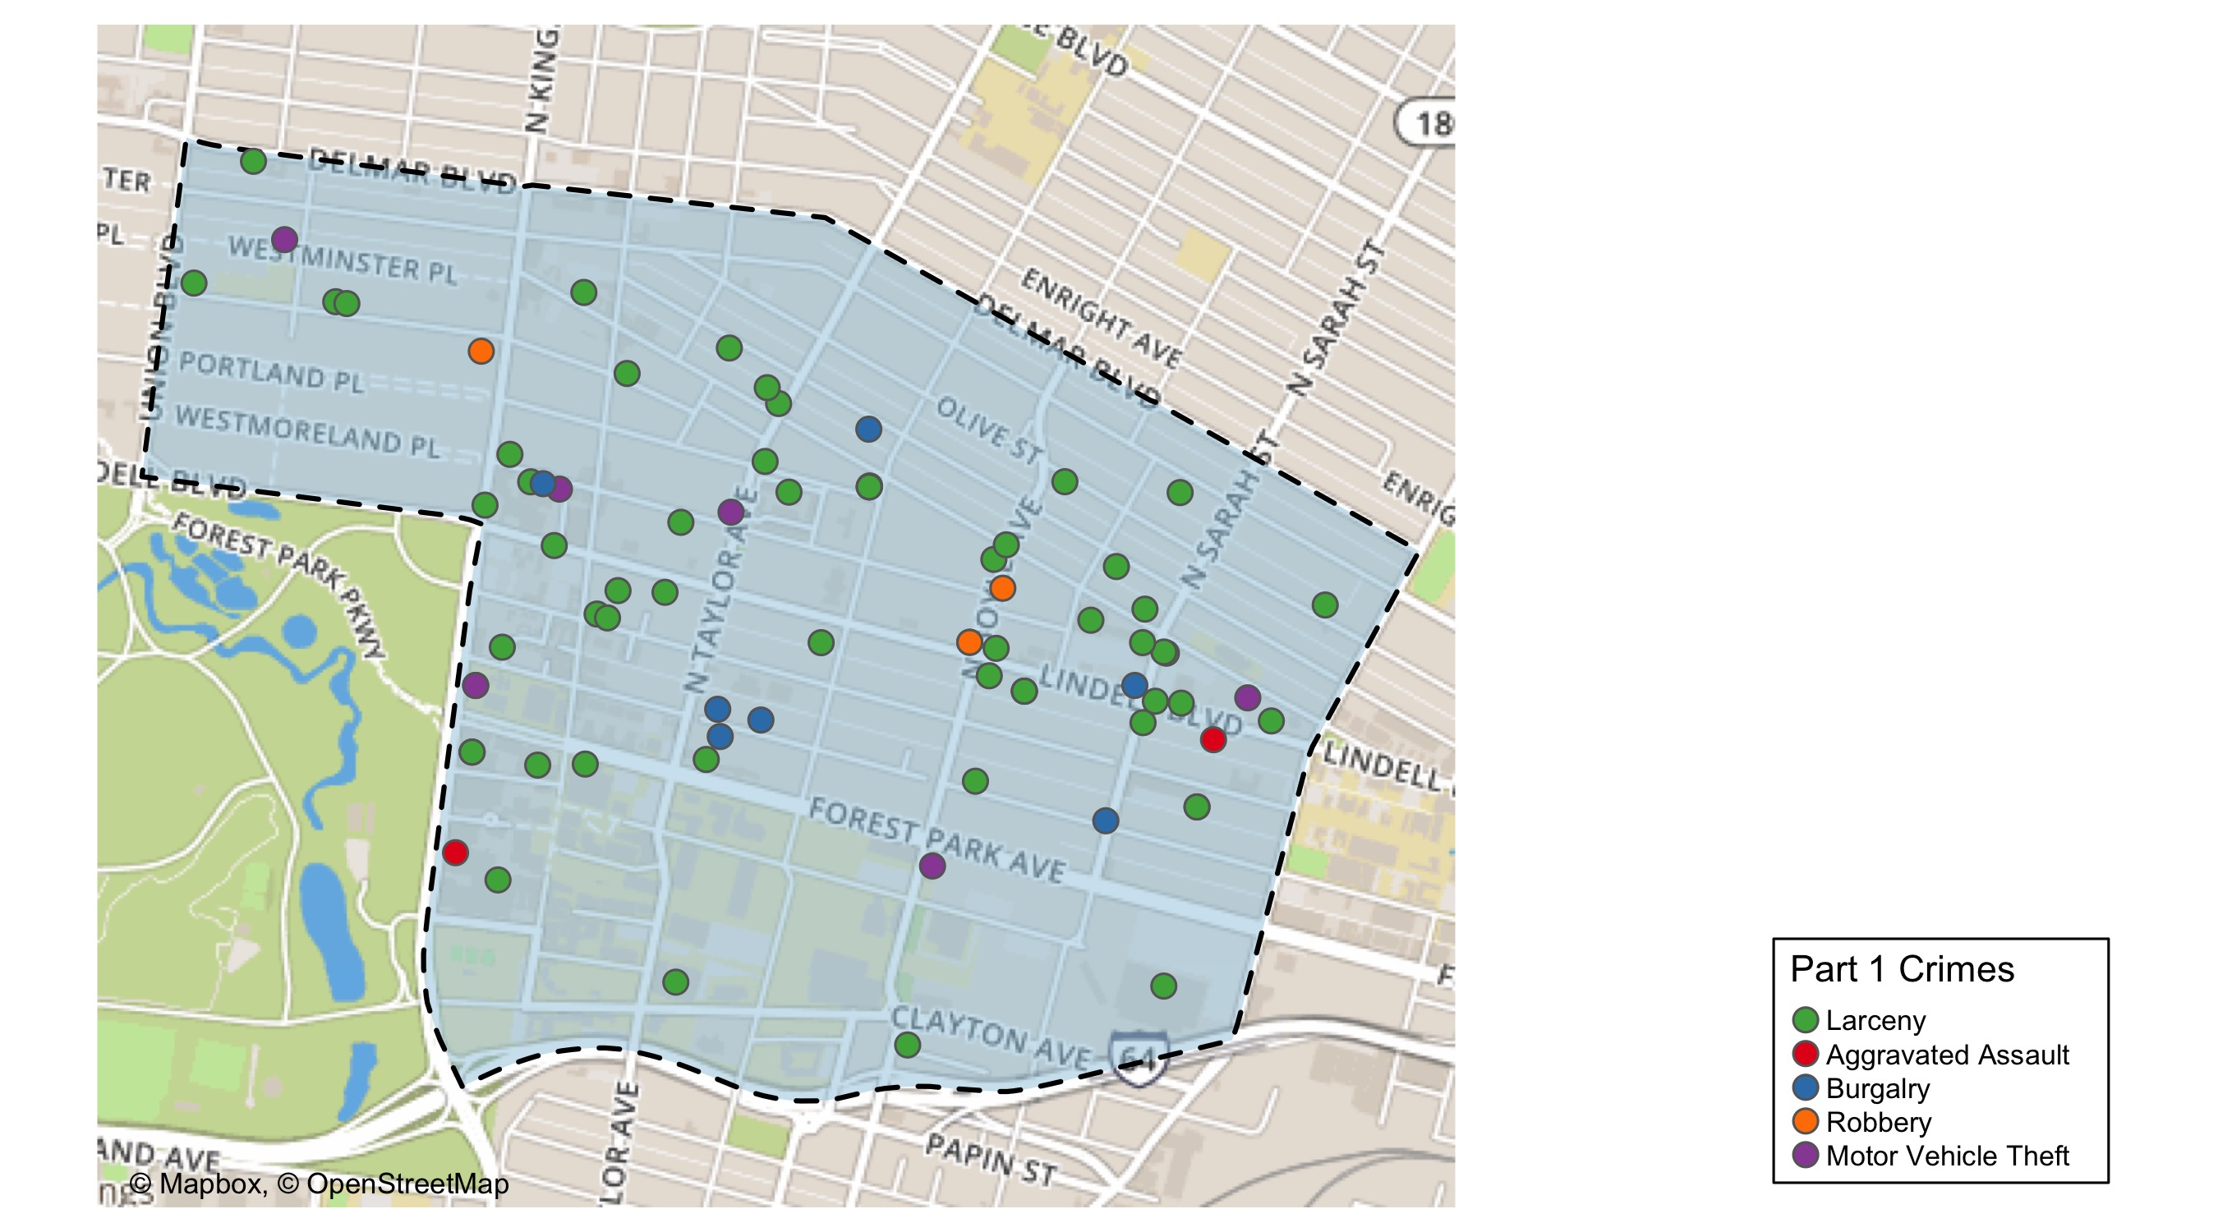
Central West End : Total Crime Map

Slide 14
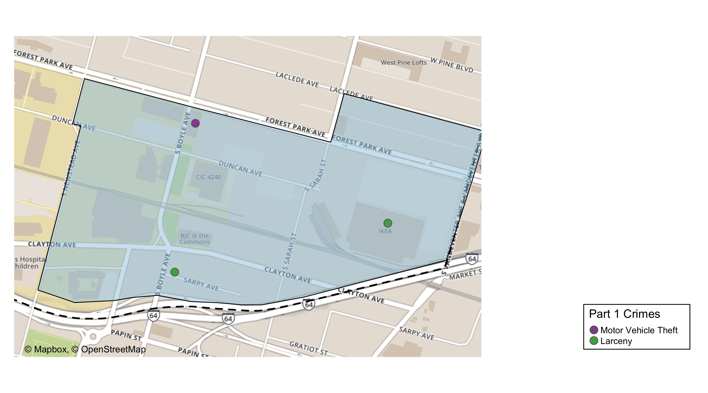
Cortex: Total Crime Map

Slide 15
Medical Center : Summary Notes
7 total crimes in December 2020
-42% change compared to December 2019 (12 total crimes)
1 crime(s) against persons in December 2020
Infinite change compared to December 2019 (0 crimes against persons)
118 total crimes in 2020
-12% change compared to this time in 2019 (134 total crimes)
19 crime(s) against persons in 2020
-21% change compared to this time in 2019 (24 crimes against persons)

Slide 16
Medical Center : Year to Year Comparison
2019 | 2019 | 2019 | 2019 | 2019 | 2019 | 2019 | 2019 | 2019 | 2019 | 2019 | 2019 | 2019 | 2019
Part 1 Crimes | Jan | Feb | Mar | Apr | May | Jun | Jul | Aug | Sep | Oct | Nov | Dec | Total
Aggravated Assault | 4 | 1 | 1 | 0 | 0 | 2 | 0 | 5 | 3 | 0 | 1 | 0 | 17
Arson | 0 | 0 | 0 | 0 | 0 | 0 | 0 | 0 | 0 | 0 | 0 | 0 | 0
Burgalry | 0 | 0 | 0 | 0 | 0 | 0 | 0 | 1 | 0 | 0 | 0 | 0 | 1
Homicide | 0 | 0 | 0 | 0 | 0 | 0 | 0 | 0 | 0 | 0 | 0 | 0 | 0
Larceny | 7 | 8 | 6 | 9 | 9 | 6 | 8 | 4 | 11 | 6 | 10 | 10 | 94
Motor Vehicle Theft | 2 | 0 | 1 | 2 | 1 | 0 | 0 | 1 | 2 | 0 | 4 | 2 | 15
Rape | 0 | 0 | 0 | 0 | 0 | 0 | 0 | 0 | 0 | 0 | 0 | 0 | 0
Robbery | 0 | 0 | 0 | 1 | 0 | 1 | 0 | 1 | 1 | 1 | 2 | 0 | 7
Total | 13 | 9 | 8 | 12 | 10 | 9 | 8 | 12 | 17 | 7 | 17 | 12 | 134
2020 | 2020 | 2020 | 2020 | 2020 | 2020 | 2020 | 2020 | 2020 | 2020 | 2020 | 2020 | 2020 | 2020
Part 1 Crimes | Jan | Feb | Mar | Apr | May | Jun | Jul | Aug | Sep | Oct | Nov | Dec | Total
Aggravated Assault | 0 | 1 | 2 | 2 | 1 | 0 | 1 | 2 | 0 | 1 | 1 | 1 | 12
Arson | 0 | 0 | 0 | 0 | 0 | 0 | 0 | 0 | 0 | 0 | 0 | 0 | 0
Burgalry | 1 | 0 | 0 | 0 | 0 | 0 | 0 | 0 | 0 | 1 | 0 | 0 | 2
Homicide | 0 | 0 | 0 | 0 | 0 | 0 | 0 | 0 | 0 | 0 | 0 | 0 | 0
Larceny | 8 | 9 | 6 | 6 | 5 | 11 | 3 | 4 | 7 | 10 | 5 | 6 | 80
Motor Vehicle Theft | 0 | 2 | 0 | 1 | 0 | 2 | 0 | 4 | 3 | 2 | 1 | 0 | 15
Rape | 0 | 1 | 0 | 0 | 0 | 0 | 0 | 0 | 0 | 0 | 1 | 0 | 2
Robbery | 1 | 3 | 0 | 0 | 0 | 1 | 1 | 0 | 0 | 1 | 0 | 0 | 7
Total | 10 | 16 | 8 | 9 | 6 | 14 | 5 | 10 | 10 | 15 | 8 | 7 | 118

Slide 17
Medical Center : Summary Tables
Day of the Week | Number of Crimes
Sun | 0
Mon | 2
Tue | 0
Wed | 1
Thu | 2
Fri | 0
Sat | 2
Total | 7
Part 1 Crimes | Number of Crimes
Aggravated Assault | 1
Larceny | 6
Total | 7
Crimes Against Persons | Number of Crimes
FALSE | 6
TRUE | 1
Total | 7
Time of Day | Number of Crimes
Day | 7
Total | 7

Slide 18
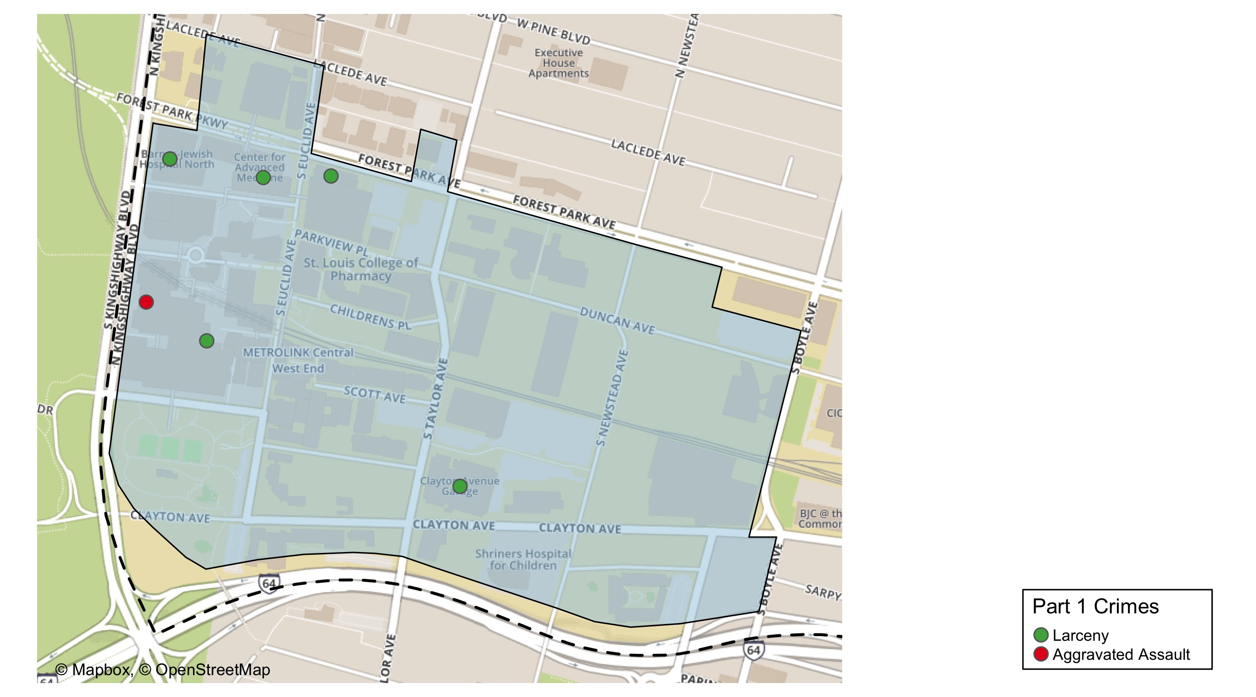
Medical Center : Total Crime Map

Slide 19
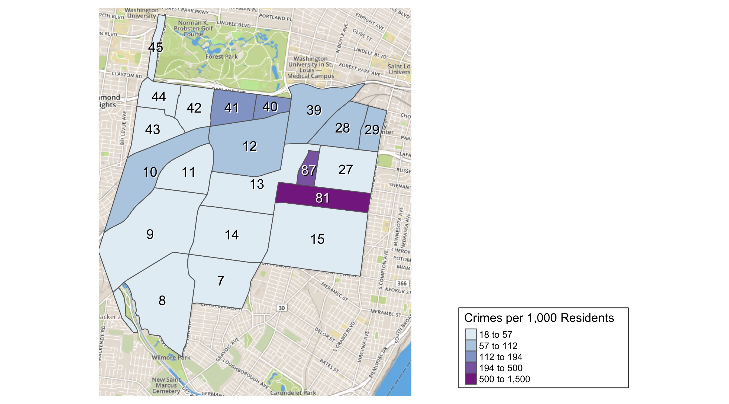
District 2: Crime Rates Map

Slide 20
District 2: Density Map Explanation
There are 23 neighborhoods in District 2. The South Hampton neighborhood is split between District 2 and District 1.
The minimum number of crimes in one neighborhood was 1 (Missouri Botanical Garden)
The maximum number of crimes in one neighborhood was 766 (Tower Grove South)
The mean number of crimes in one neighborhood was 176.81
The minimum rate of crimes in one neighborhood was 18.11 (Southampton)
The maximum rate of crimes in one neighborhood was 1500 (Tower Grove Park)
The mean rate of crimes in one neighborhood was 153.62

Slide 21
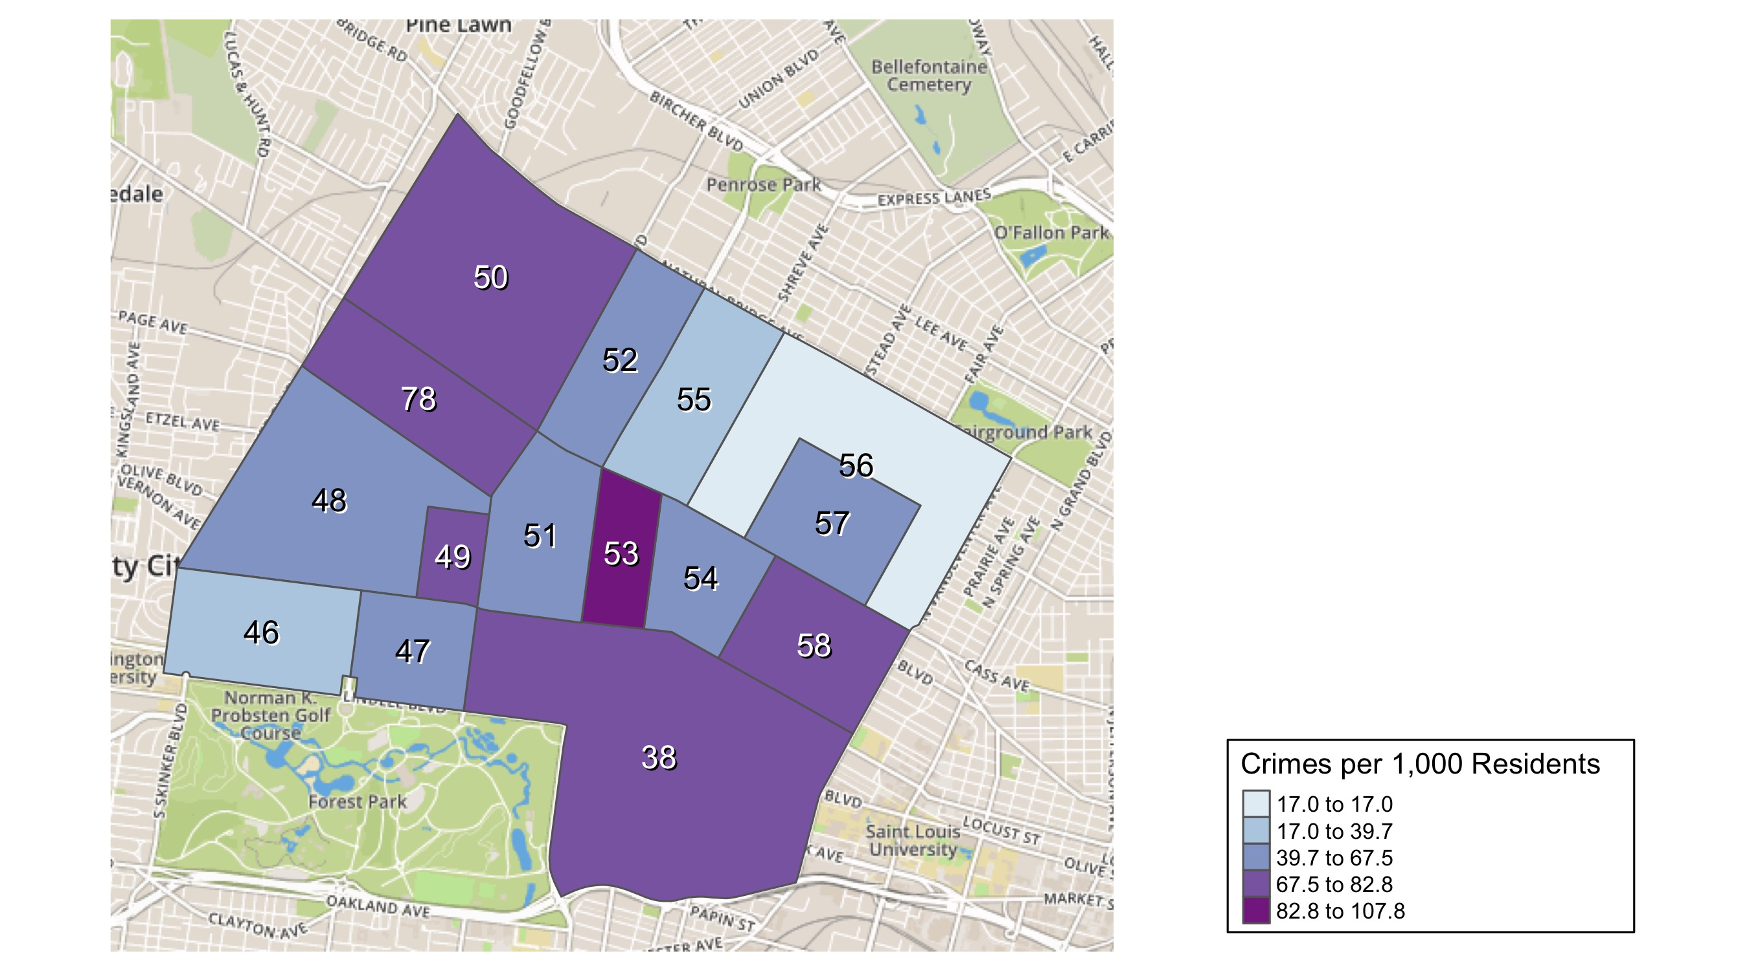
District 5: Crime Rates Map

Slide 22
District 5: Density Map Explanation
There are 15 neighborhoods in District 5
The minimum number of crimes in one neighborhood was 76 (Visitation Park)
The maximum number of crimes in one neighborhood was 1186 (Central West End)
The mean number of crimes in one neighborhood was 257.27
The minimum rate of crimes in one neighborhood was 16.97 (Greater Ville)
The maximum rate of crimes in one neighborhood was 107.82 (Fountain Park)
The mean rate of crimes in one neighborhood was 64.22

Slide 23
Forest Park Southeast : Neighborhood Detail
Appendix 1

Slide 24
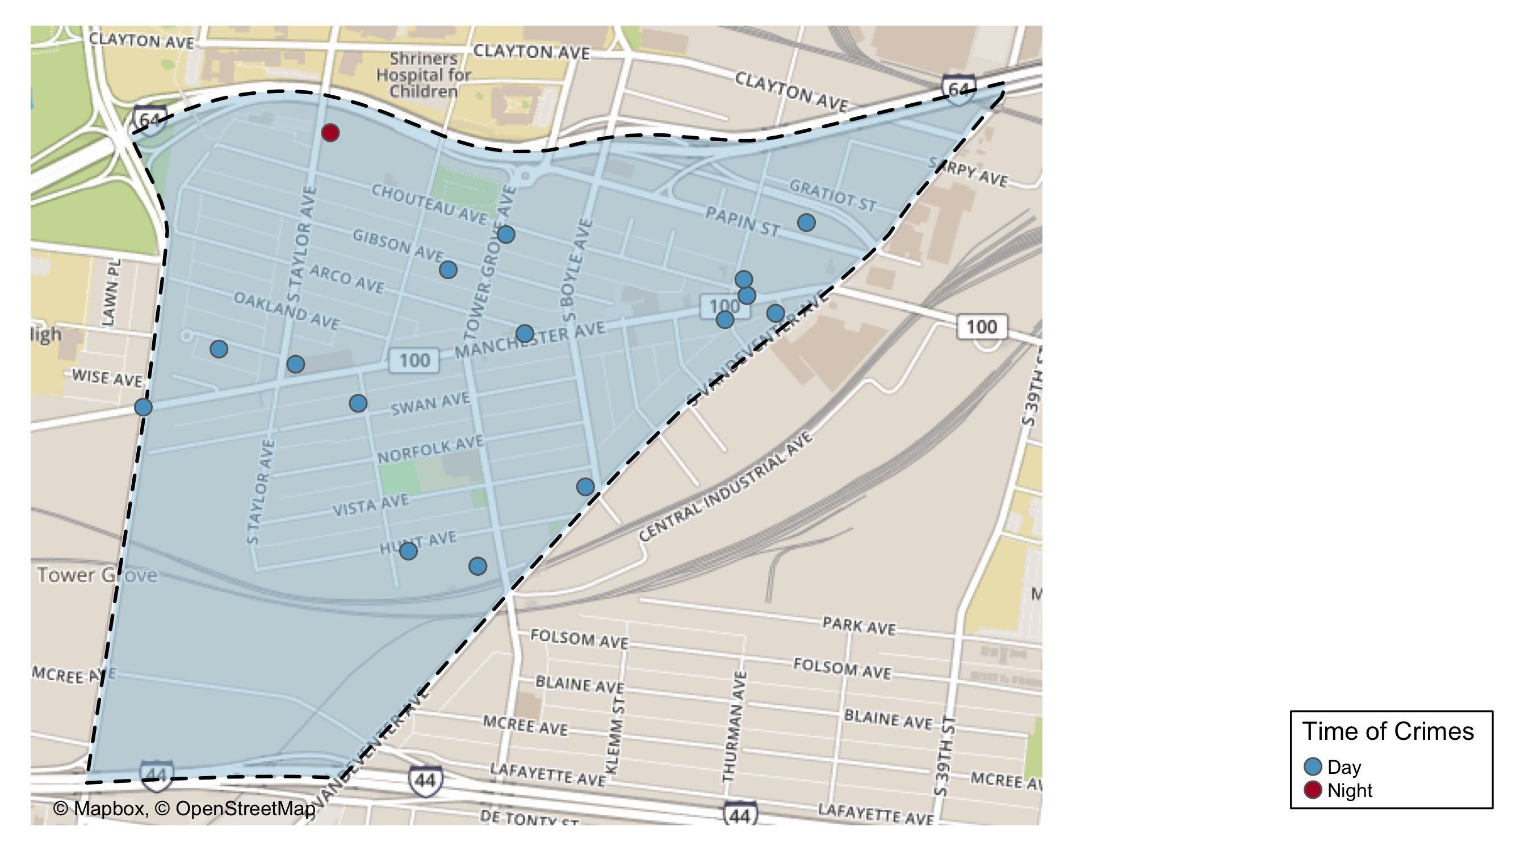
Forest Park Southeast : Time of Crimes Map

Slide 25
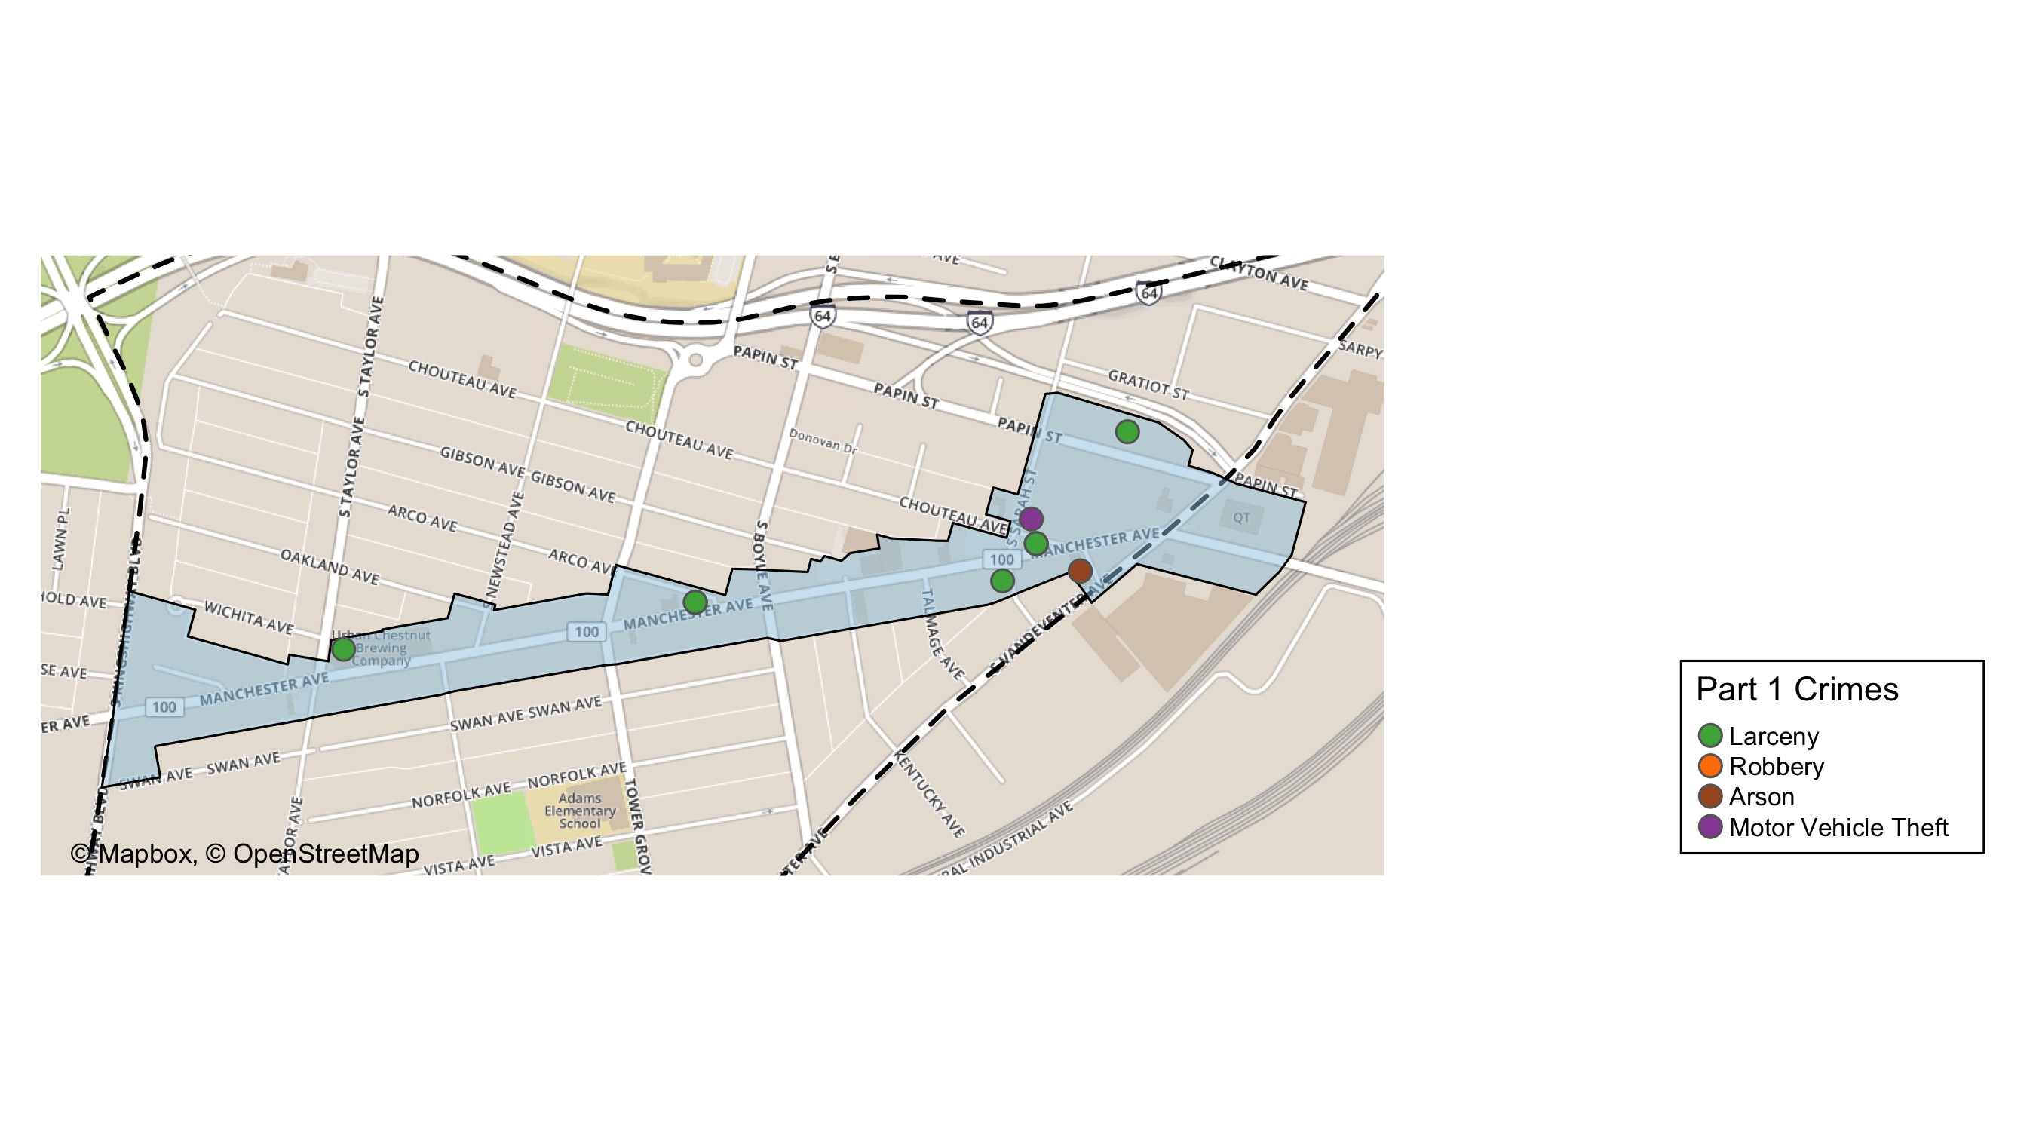
Grove Community Improvement District: Total Crime Map

Slide 26
Forest Park Southeast : Larceny Breakdown
Day of the Week | Number of Crimes
Sun | 3
Mon | 3
Tue | 3
Wed | 0
Thu | 1
Fri | 2
Sat | 4
Total | 16
Type of Larceny | Number of Crimes
All Other | 1
From Building | 1
From Motor Vehicle | 11
Motor Vehicle Parts | 3
Total | 16
Time of Day | Number of Crimes
Day | 15
Night | 1
Total | 16
Monetary | Number of Crimes
$500 - $24,999 | 4
Under $500 | 12
Total | 16

Slide 27
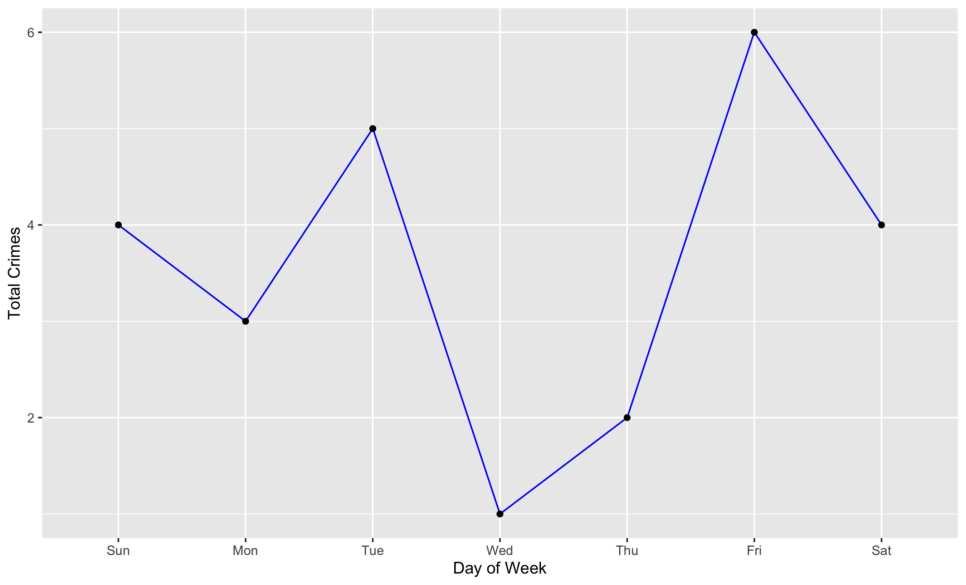
Forest Park Southeast : Total Crimes by Days of the Week

Slide 28
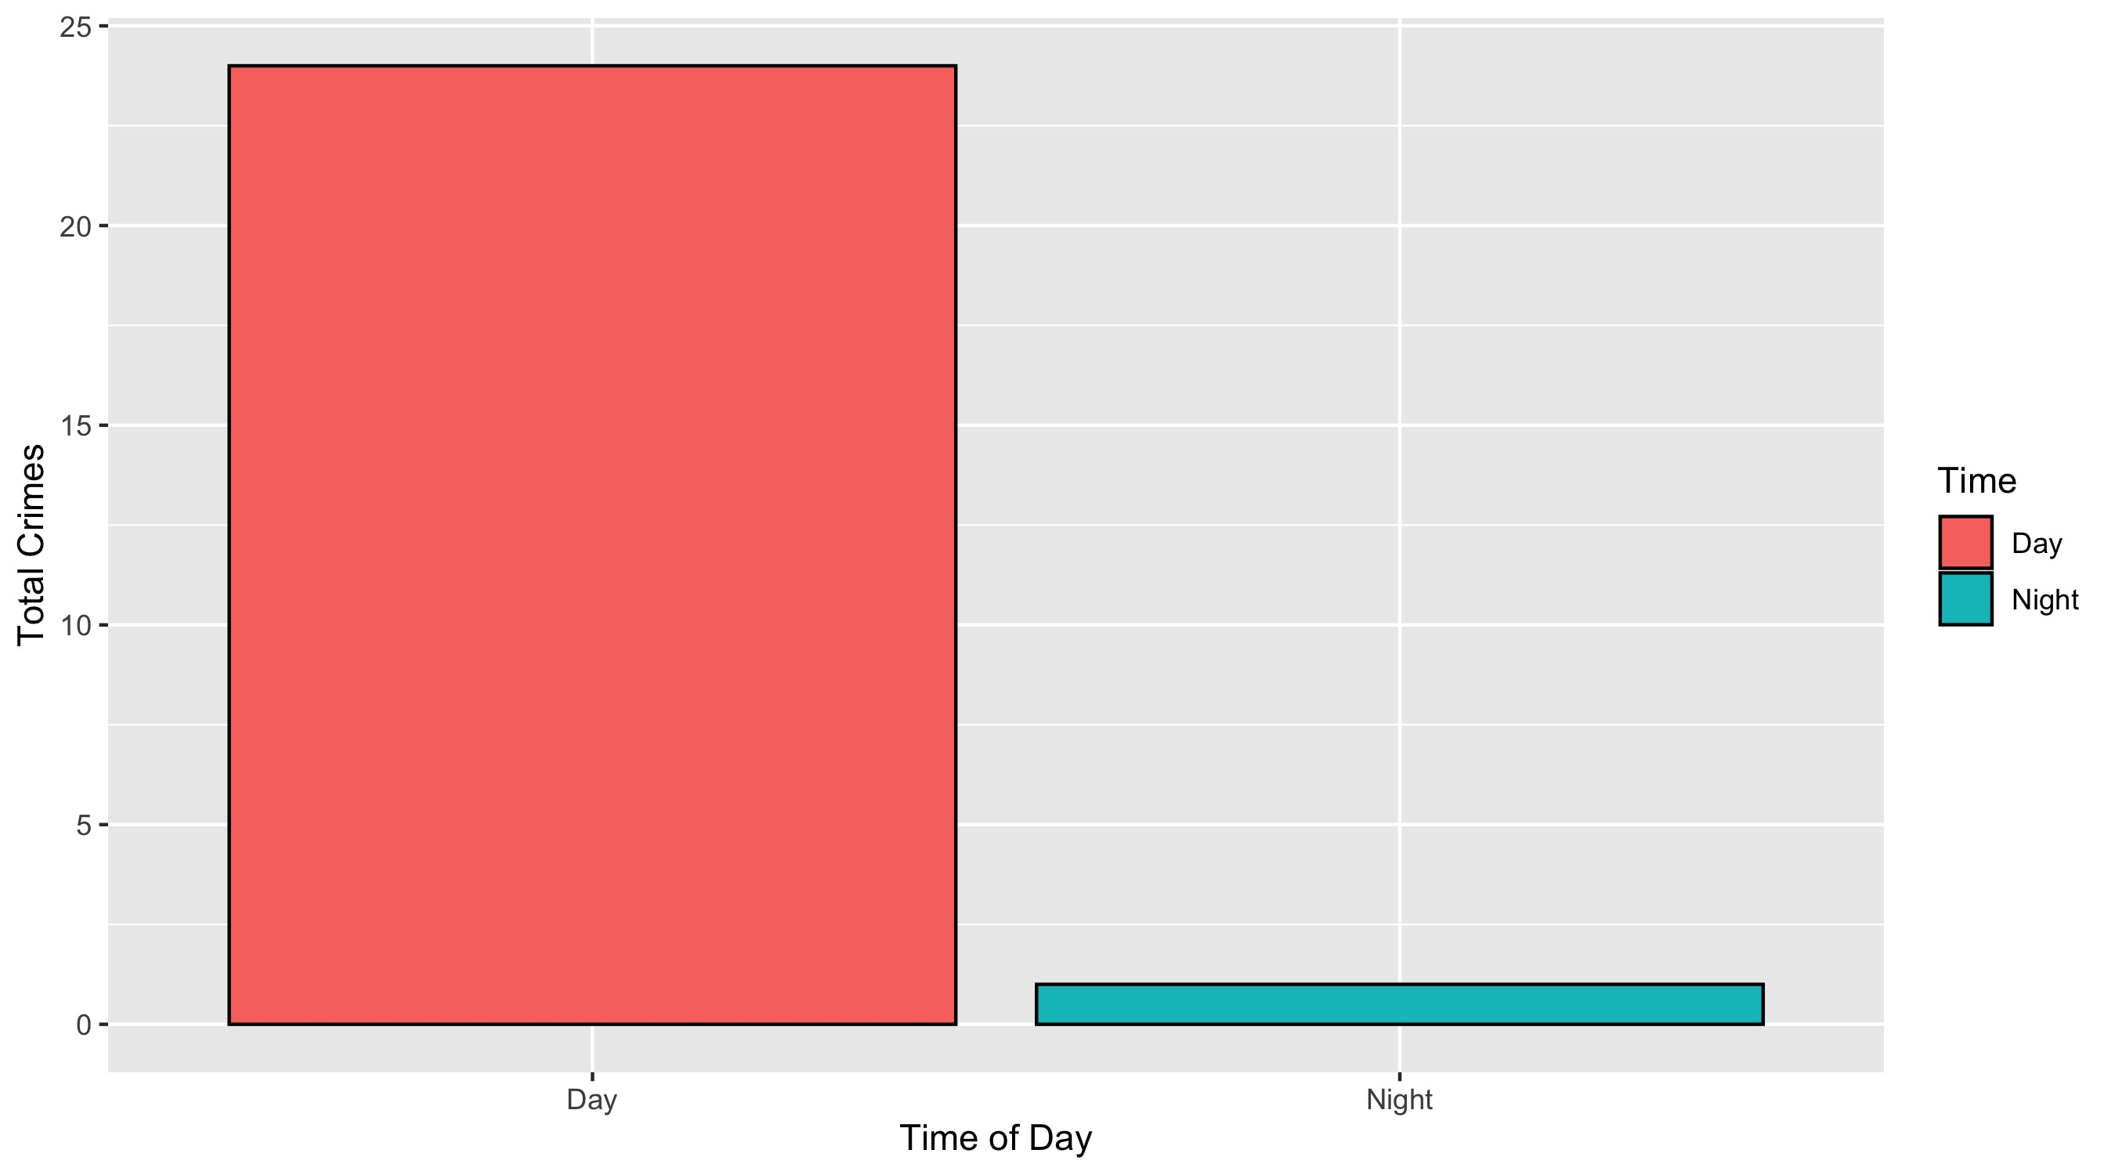
Forest Park Southeast : Crimes by Time of Day

Slide 29
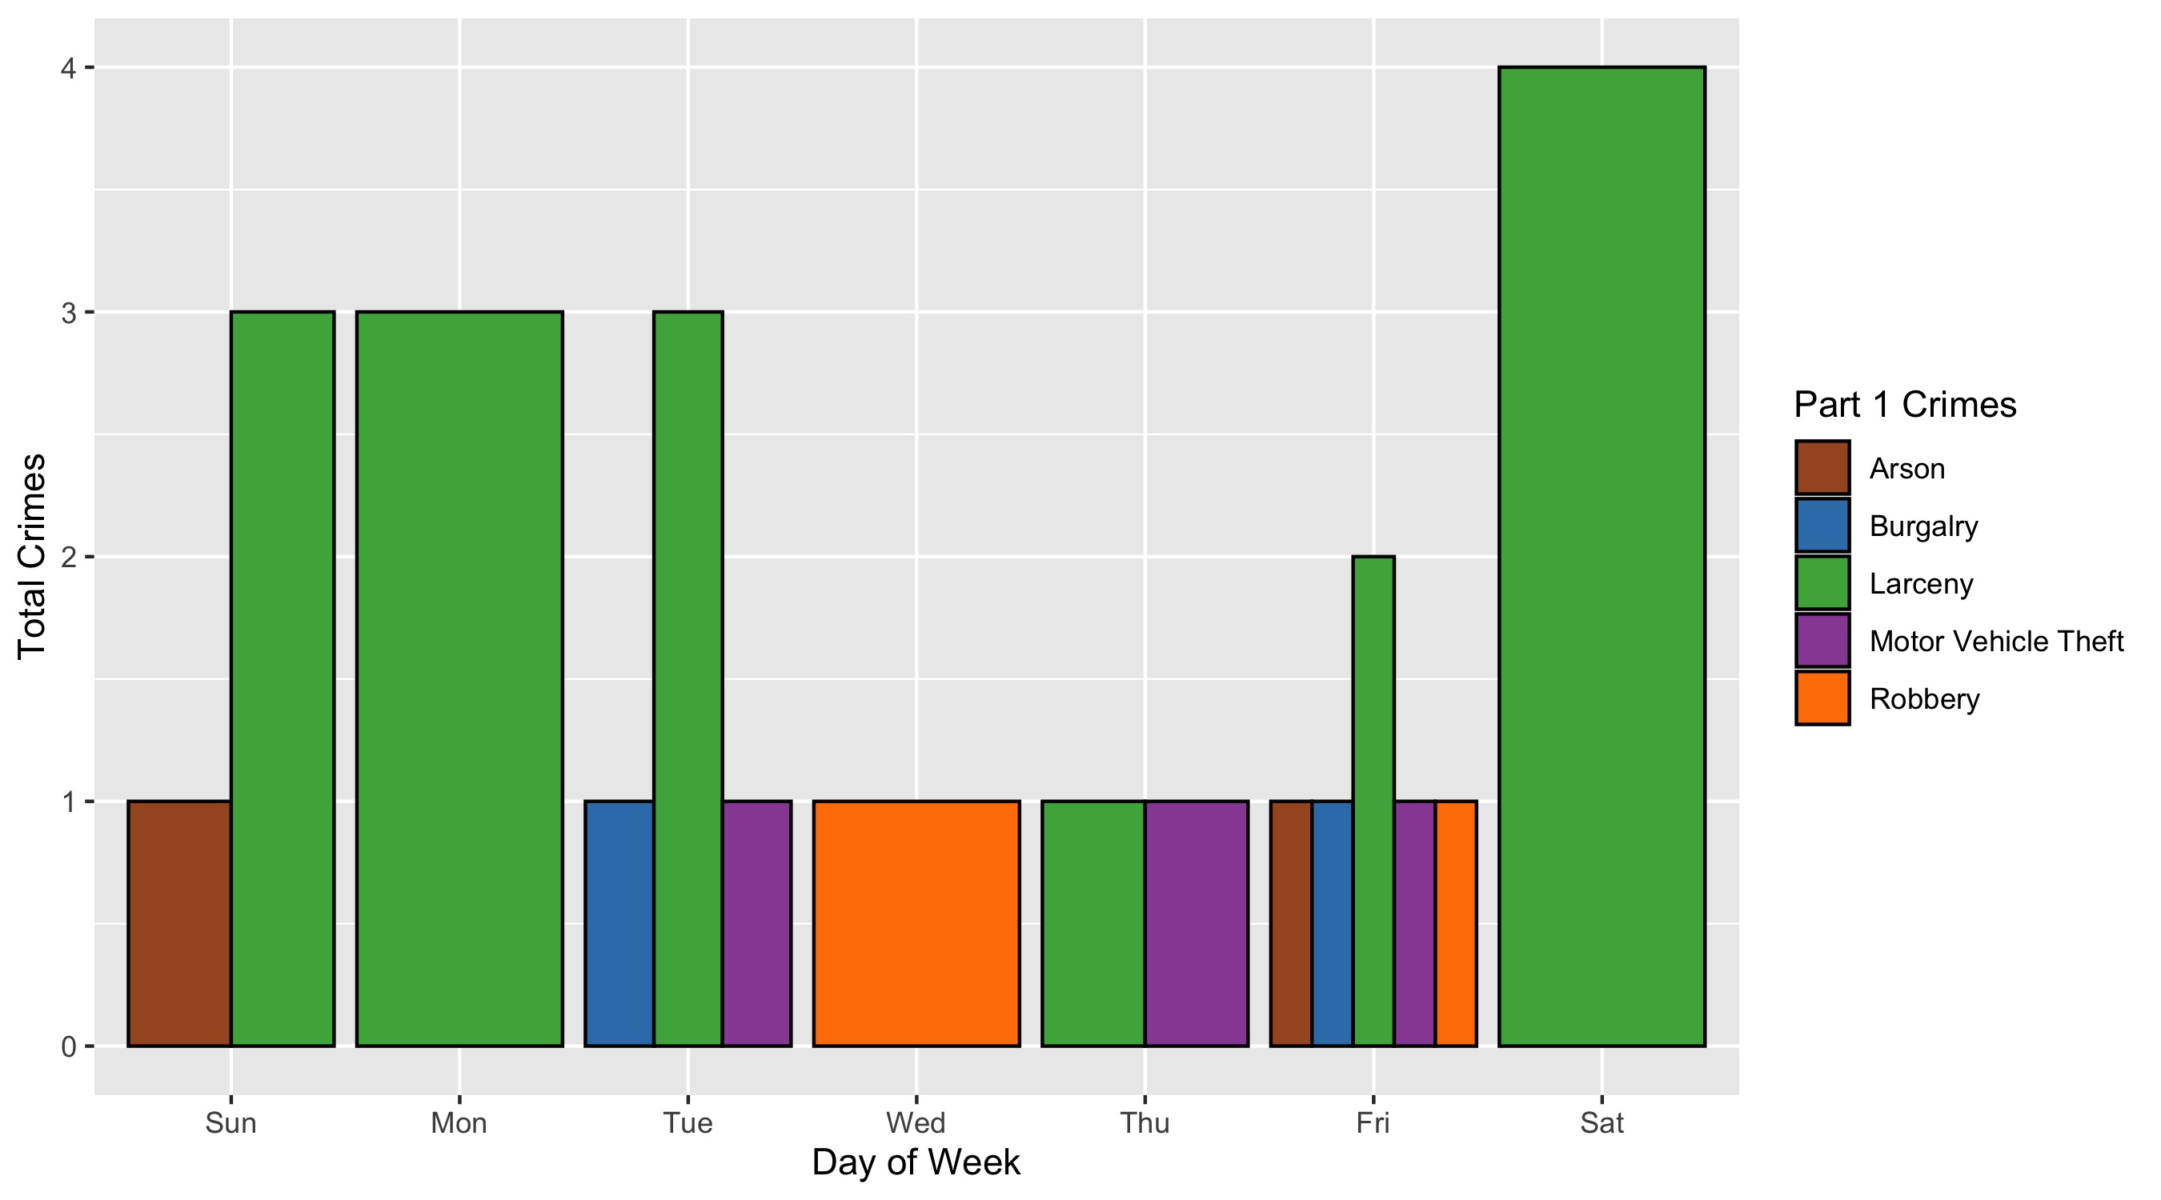
Forest Park Southeast : Crimes by Day & Category

Slide 30
Central West End : Neighborhood Detail
Appendix 2

Slide 31
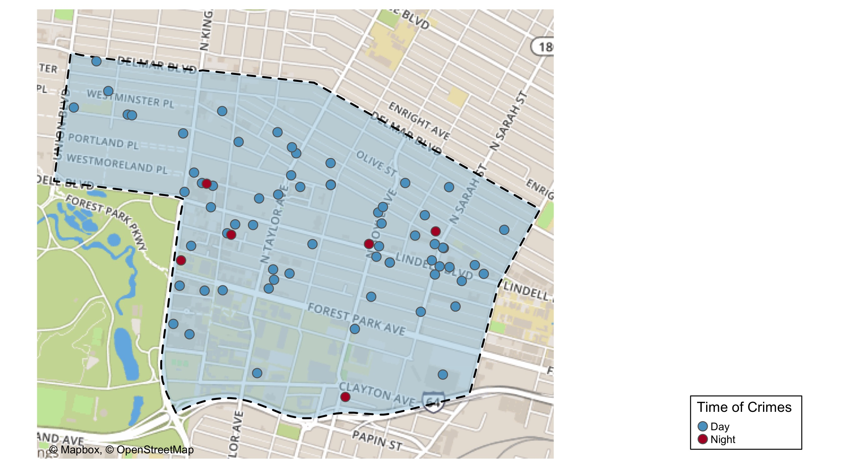
Central West End : Time of Crimes Map

Slide 32
Central West End : Larceny Breakdown
Day of the Week | Number of Crimes
Sun | 7
Mon | 9
Tue | 6
Wed | 12
Thu | 13
Fri | 3
Sat | 9
Total | 59
Type of Larceny | Number of Crimes
All Other | 8
Bicycle | 1
From Building | 11
From Motor Vehicle | 18
Motor Vehicle Parts | 14
Shoplifting | 7
Total | 59
Time of Day | Number of Crimes
Day | 56
Night | 3
Total | 59
Monetary | Number of Crimes
$500 - $24,999 | 12
Under $500 | 47
Total | 59

Slide 33
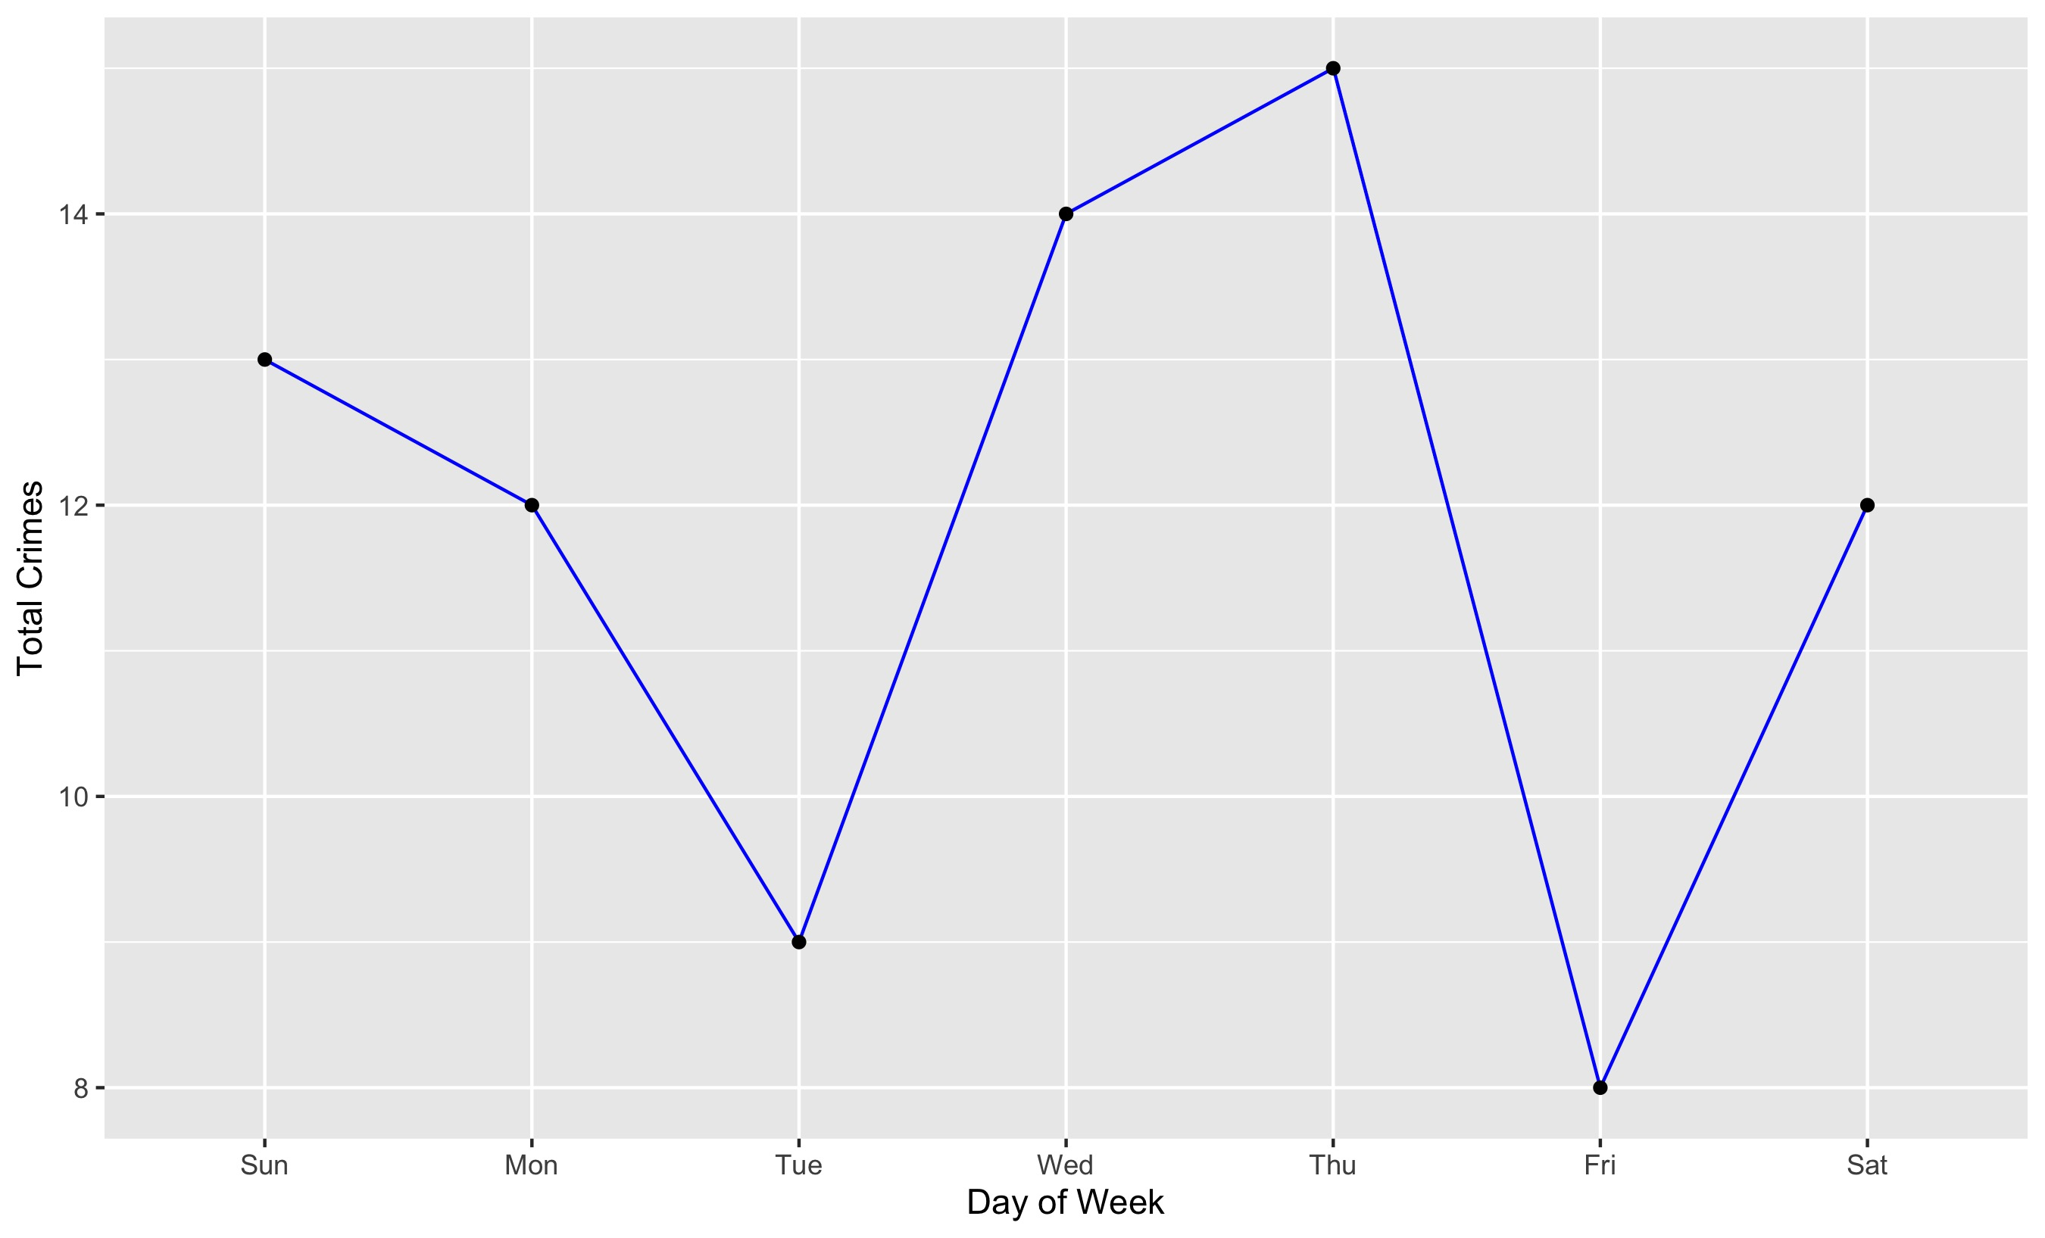
Central West End : Total Crimes by Days of the Week

Slide 34
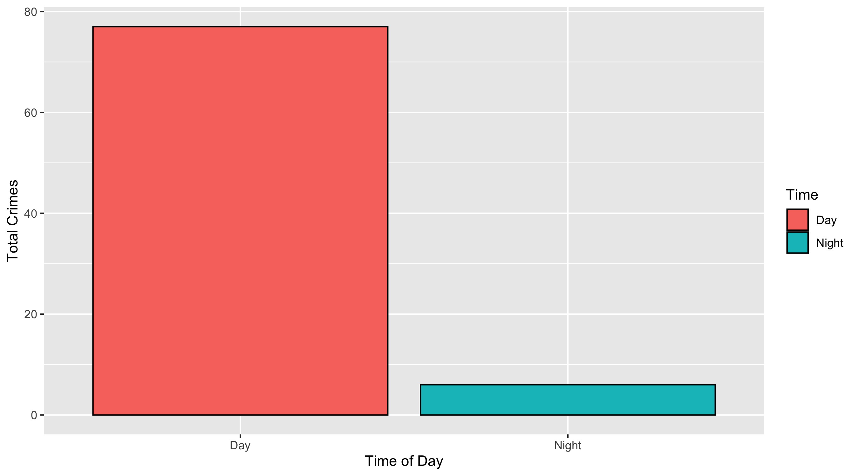
Central West End : Crimes by Time of Day

Slide 35
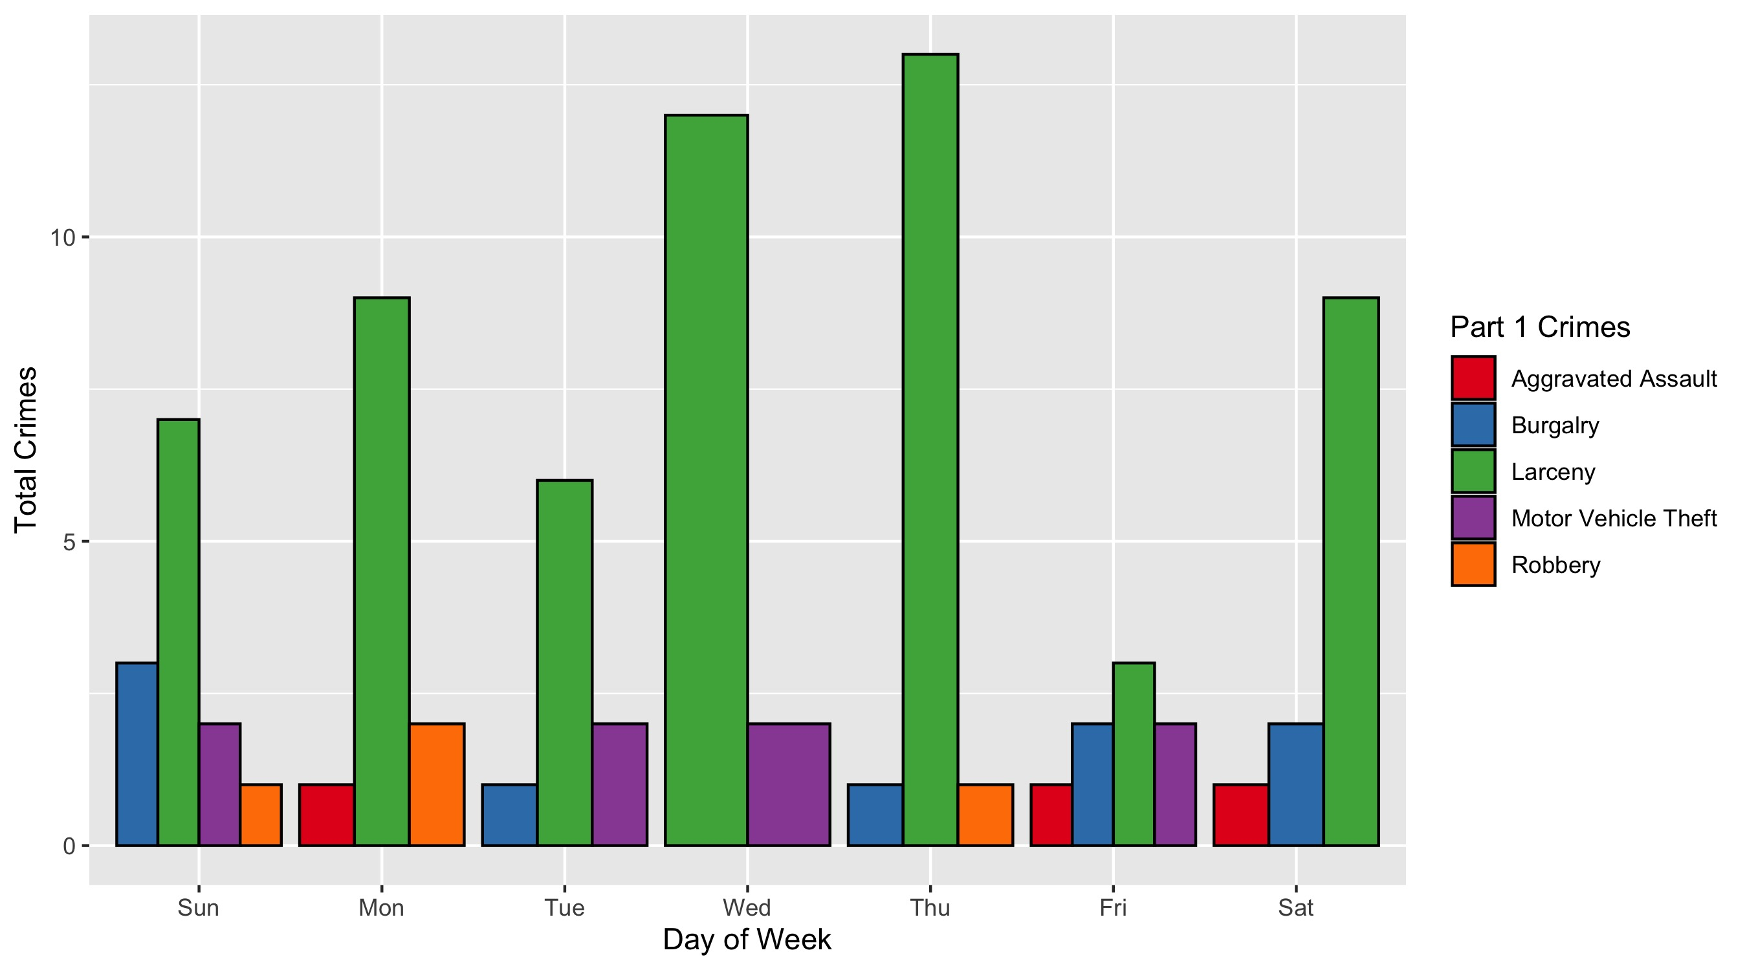
Central West End : Crimes by Day & Category

